Slide 1
Department of Biology
Faculty of science

Slide 2
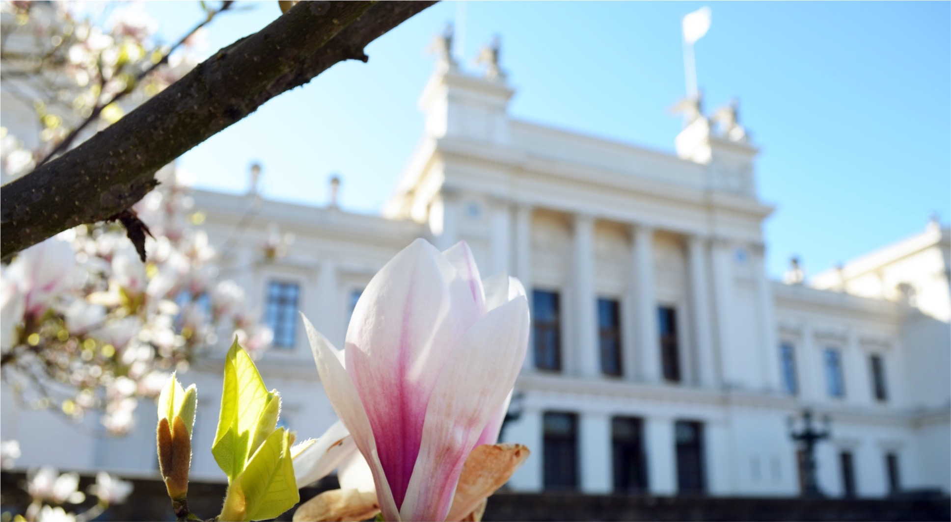
Lund University

Slide 3
We are united in our efforts to understand, explain and improve our world and the human condition

Slide 4
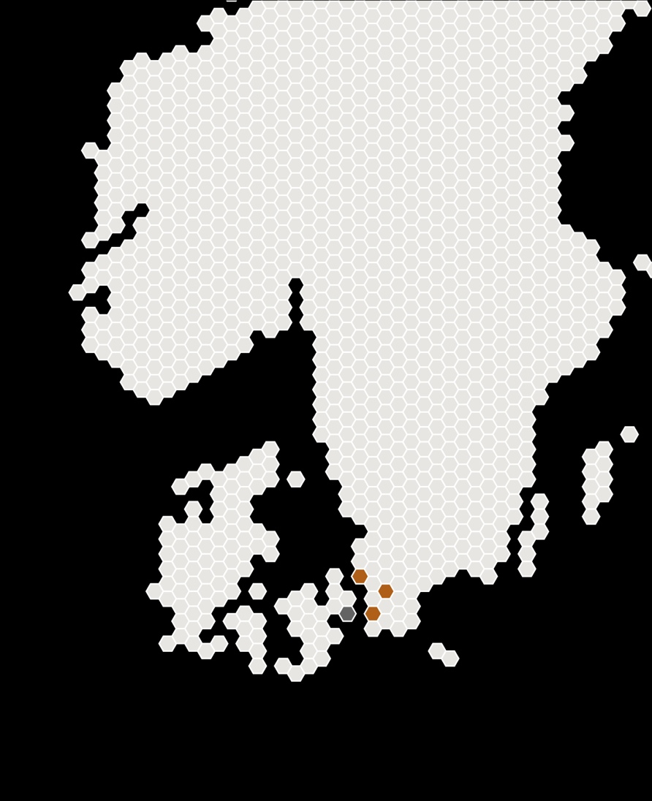
Lund University – a world class university
Founded 1666
Ranked among the world’s top 100 universities
49 000 students, 27% international
8 600 employees, approximately 770 professors,
4 400 lecturers, researchers and doctoral students, and 3 000 technical/administrative staff
266 educational programmes, 161 at advanced level
1 495 free standing courses, 8% are given in English
HELSINGBORG
LUND
MALMÖ

Slide 5
A comprehensive university – eight faculties
Economics and management
Engineering and technology
Fine arts, music, and theatre
Humanities and theology
Law
Medicine
Science
Social sciences

Slide 6
World University Rankings
 | QS* | THE** | Shanghai***
2022 | 95 | 119 | 151–200
2021 | 87 | 116 | 151–200
2020 | 97 | 103 | 151–200
*QS World University Rankning
**Times Higher Education
***Shanghai ranking – Academic Ranking of World Universities (ARWU)

Slide 7
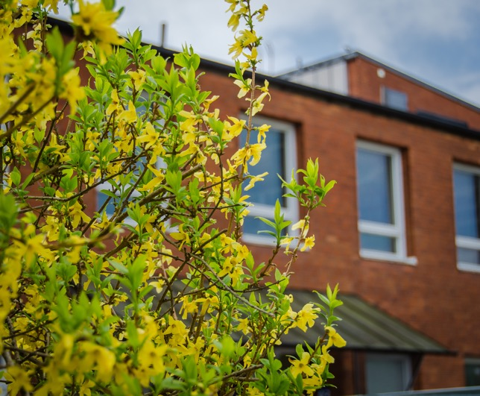
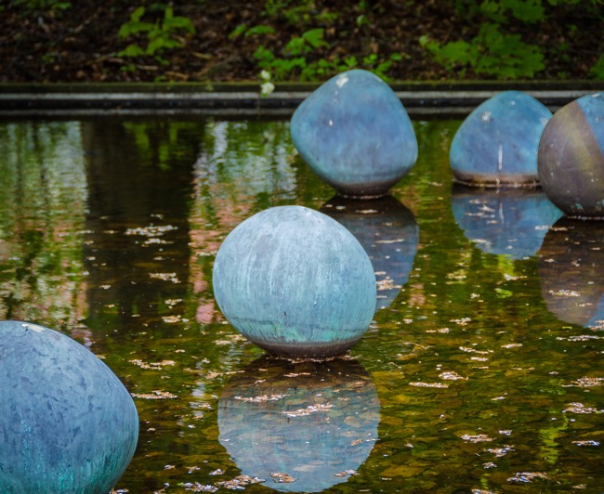
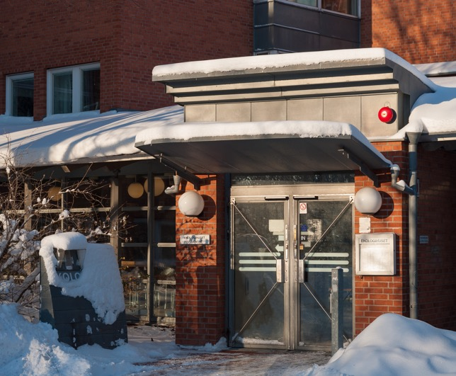
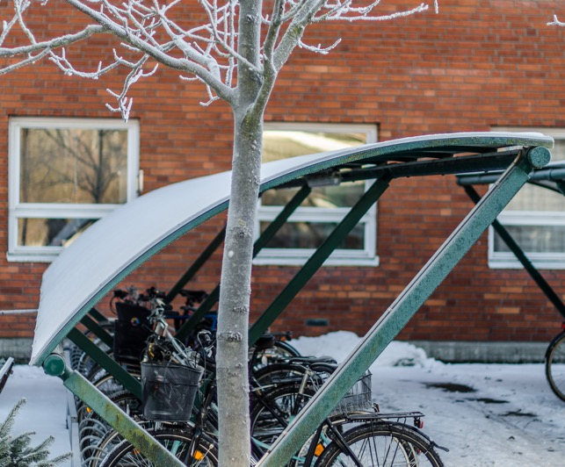
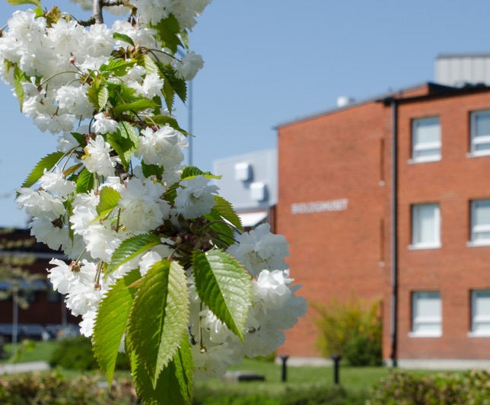
Department of Biology

Slide 8
Department of Biology
Created in 2010 when five departments, some with histories back to 1666, were merged
From molecules to ecosystems,
from genetic code to behaviour
Empiric and theoretic research
Basic research driven by curiosity, environmental monitoring, commercial applications
Research museum

Slide 9
Funding
Total revenue: SEK 368 million
Notes:
Central government allocation – funding from the state.
Government grant providers – granted in competition, i.e. Vinnova, Vetenskapsrådet, Formas, etc.
Other Swedish grant providers – non governmental, i.e. Knut och Alice Wallenberg, Stiftelsen för strategisk forskning, Crafoord etc.
Foreign grant providers – competition, i.e European Research Council etc.
Applied research – can be different things, for instance conferences, teaching at other universities, research done for other organizations an companies etc.

Slide 10
Personnel
392 employees (49% female)

Slide 11

An international department
At the Department of Biology we have personnel and students from all around the world.

Slide 12
Education – basic and advanced level
Students per year 450
Examina 150
Programmes 13
Courses 60
Well-known researchers teach
our students in an active research environment

Slide 13
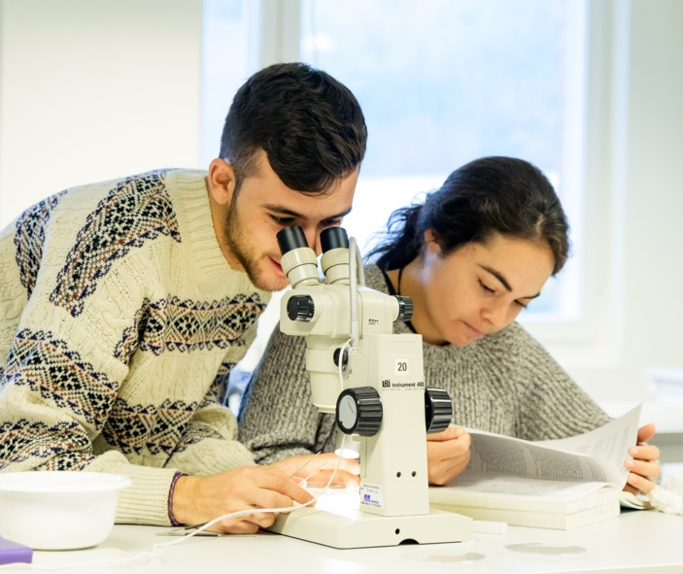
Education – basic and advanced level
Bachelor’s degree programme
Biology
Molecular biology
Master’s degree programme
Biology – 6 specialisations
Molecular biology – 4 specialisations
Bioinformatics

Slide 14
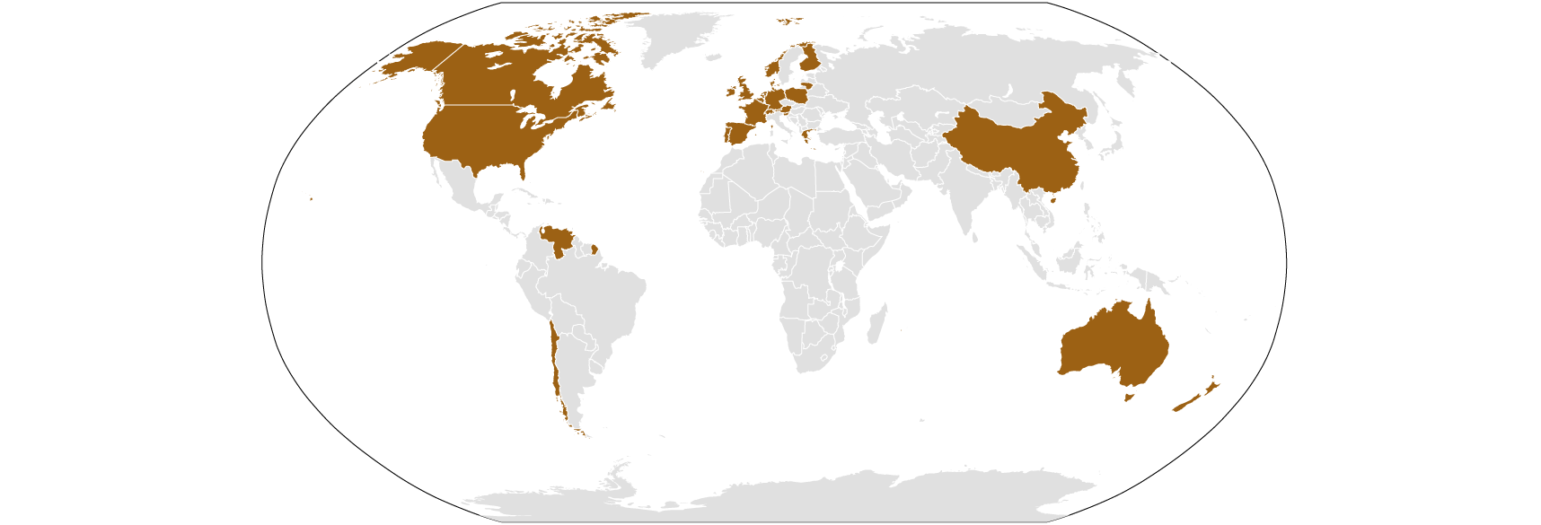
Outgoing and incoming students
Lund University –
Sweden’s most
international university
Biology 2022
50 exchange students
140 international master students

Slide 15
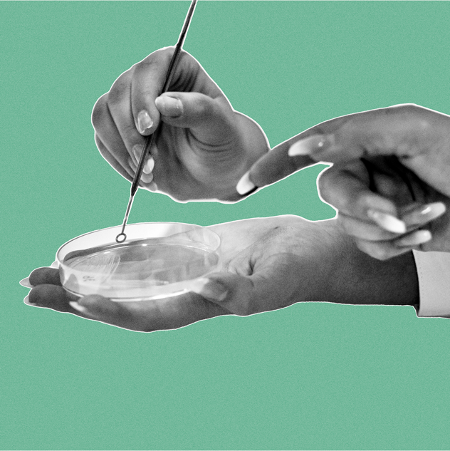
Research
Basic and applied research from molecules, genetic code and protein production to ecological systems and behaviour
23 research groups
5 biggest grant providers 2022 – Swedish Research Council, European Commission, Knut and Alice Wallenberg Foundation, Formas, and the Swedish Environmental Protection Agency

Slide 16

Research figures
135
Other
academic staff
9
Degree of Doctor
34
Professors
350
Publikations
87
Doctoral students

Slide 17
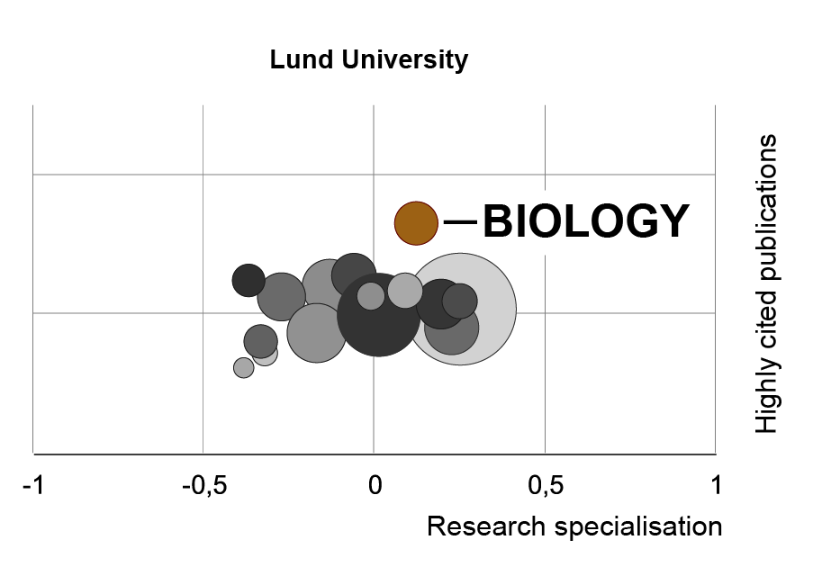
Research – citation impact
Notes:
Adapted from The Swedish Research Barometer 2021 published by The Swedish Research Council

Slide 18
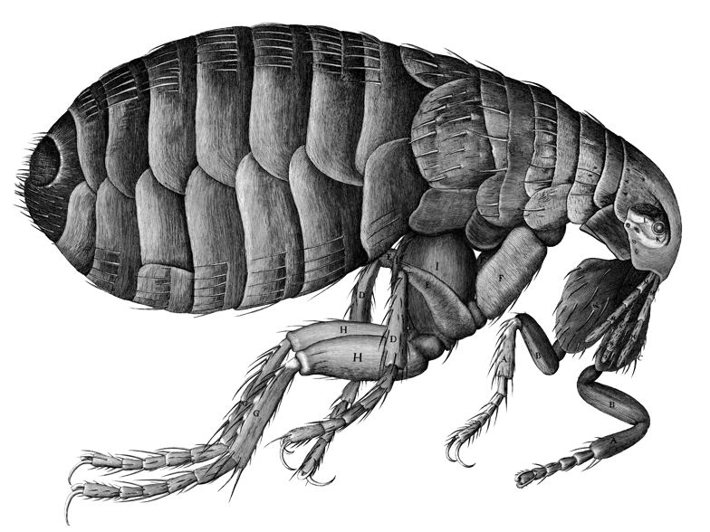
Biological museum
More than 300 years old research museum
Around 14.5 million plants and animals, >10 000 of these are type specimen
Botanical collections
Entomological collections
Zoological collections

Slide 19
Collaboration & outreach
TV/radio & other media
Popular science lectures
Q & A
Citizen Science

Slide 20
Department organisation
Biology Department Board | Head & Deputy Head of Department | Head of Department Council
Groups & Committees | Research units | Other units
Biology doctoral students council First & second cycle programmes board Gender equality and equal opportunities group Heads of units Health, environment & safety committee Infrastructure group Research studies board | Aquatic Ecology Biodiversity Evolutionary Ecology Functional Zoology Molecular Ecology, Microbial Ecology & Evolutionary Genetics Molecular Cell Biology | Biological Museum Lund Protein Production Platform (LP3)
Research infrastructure
Head of Department Office
Education Office

Slide 21
End slide, logotype only

